Slide 1
IoT Reference Architecture

Slide 2
IoT Reference Architecture View
Functional View: Description of what the system does, and its main functions.
• Information View: Description of the data and information that the system handles.
• Deployment and Operational View: Description of the main real world components of the system such as devices, network routers,
servers, etc.

Slide 3
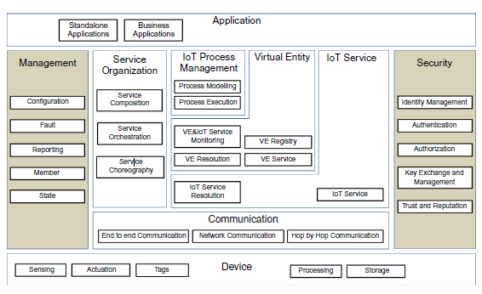
IoT Functional View

Slide 4
Types of Function View
1.1 Device and Application functional group
For convenience the Device FG contains the Sensing, Actuation, Tag, Processing, Storage FCs, or simply components.
These components represent the resources of the device attached to the Physical Entities of interest. The Application FG contains either standalone applications (e.g. for iOS, Android, Windows phone), or Business Applications that connect the IoT system to an Enterprise system.

Slide 5
1.2 Communication functional group
The Communication FG contains the End-to-End Communication, Network Communication, and Hop-by-Hop communication components:
• The Hop-by-Hop Communication is applicable in the case that devices are equipped with mesh radio networking technologies such as IEEE 802.15.4 for which messages have to traverse the mesh
from node-to-node (hop-by-hop) until they reach a gateway node which forwards the message
(if needed) further to the Internet.

Slide 6
1.3 IoT Service functional group
The IoT Service FG consists of two FCs: The IoT Service FC and the IoT Service Resolution FC:
• The IoT Service FC is a collection of service implementations, which interface the related and associated Resources.
For a Sensor type of a Resource, the IoT Service FC includes Services that receive requests from a User and returns the Sensor Resource value in synchronous or asynchronous (e.g. subscription/notification) fashion.

Slide 7
The IoT Service Resolution FC contains the necessary functions to realize a directory of IoT Services that allows dynamic management of IoT
Service descriptions and discovery/lookup/resolution of IoT Services by
other Active Digital Artifacts.
Dynamic management includes methods such as creation/update/deletion (CUD) of Service description, and can be invoked by both the
IoT Services themselves, or functions from the Management FG (e.g. bulk creation of IoT Service descriptions upon system start-up).

Slide 8
1.4 Virtual Entity functional group
The Virtual Entity FG contains functions that support the interactions between Users and Physical Things through Virtual Entity services.
An example of such an interaction is the query to an IoT system of the form, “What is the temperature in the conference room Titan?” The Virtual
Entity is the conference room “Titan,” and the conference room attribute of interest is “temperature.”
The Virtual Entity Service FC enables the interaction between Users and Virtual Entities by means of reading and writing the Virtual Entity attributes (simple or complex), which can be read or written.

Slide 9
The Virtual Entity Registry FC maintains the Virtual Entities of interest for the specific IoT system and their associations. The component offers
services such as creating/reading/updating/deleting Virtual Entity descriptions and associations.
The Virtual Entity Resolution FC maintains the associations between Virtual Entities and IoT Services, and offers services such as creating/reading/updating/deleting associations as well as lookup and discovery of associations.

Slide 10
The Virtual Entity and IoT Service Monitoring FC includes:
functionality to assert static Virtual Entity IoT Service associations,
(b) functionality to discover new associations based on existing associations or
Virtual Entity attributes such as location or proximity, and
(c) continuous monitoring of the dynamic associations between Virtual Entities and IoT
Services and updates of their status in case existing associations are not
valid any more.

Slide 11
1.5 IoT process management functional group
The IoT Process Management FG aims at supporting the integration of business processes with IoT-related services. It consists of two FCs:
• The Process Modeling FC provides that right tools for modeling a business process that utilizes IoT-related services.
• The Process Execution FC contains the execution environment of the process models created by the Process Modelling FC and executes the created processes by utilizing the Service Organization FG in order to resolve high-level application requirements to specific IoT services.

Slide 12
1.6 Service Organization functional group
The Service Organization FG acts as a coordinator between different Services offered by the system
1.7 Security functional group
The Security FG contains the necessary functions for ensuring the security and privacy of an IoT system using Identity Management, Authentication and Authorization , key exchange and trust and .Reputation.

Slide 13
1.8 Management functional group
The Management FG contains system-wide management functions that may use individual FC management interfaces. It is not responsible for the
management of each component, rather for the management of the system as a whole.
It consists of the following FCs
The Configuration FC maintains the configuration of the FCs and the Devices in an IoT system.
b. The Fault FC detects, logs, isolates, and corrects system-wide faults if
possible.

Slide 14
c. The Member FC manages membership information about the relevant entities in an IoT system.
d. The State FC is similar to the Configuration FC, and collects and logs state information from the current FCs, which can be used for fault diagnosis, performance analysis and prediction, as well as billing purposes.
e. The Reporting FC is responsible for producing compressed reports about the system state based on input from FCs.

Slide 15
2. Information view
The information view consists of
(a) the description of the information handled in the IoT System, and
(b) the way this information is handled in the
system; in other words, the information lifecycle and flow (how information is created, processed, and deleted), and the information handling components.
The Information view having the following sub-section

Slide 16
2.1 Information description
The pieces of information handled by an IoT system complying to an ARM such as the IoT-A (Carrez et al. 2013) are the following:
• Virtual Entity context information, i.e. the attributes (simple or complex) as represented by parts of the IoT Information model (attributes that have values and metadata such as the temperature of a room).
• IoT Service output itself is another important part of information generated by an IoT system.
For example, this is the information generated by
interrogating a Sensor or a Tag Service.

Slide 17
• Virtual Entity descriptions in general, which contain not only the attributes coming from IoT Devices (e.g. ownership information).
• Associations between Virtual Entities and related IoT Services.
• Virtual Entity Associations with other Virtual Entities (e.g. Room #123 is on Floor #7).
• IoT Service Descriptions, which contain associated Resources, interface descriptions, etc.
• Resource Descriptions, which contain the type of resource (e.g. sensor), identity, associated Services, and Devices.
• Device Descriptions such as device capabilities (e.g. sensors, radios).

Slide 18
• Descriptions of Composed Services, which contain the model of how a complex service is composed of simpler services.
• IoT Business Process Model, which describes the steps of a business process utilizing other IoT-related services (IoT, Virtual Entity, Composed Services).
• Security information such as keys, identity pools, policies, trust models, reputation scores, etc.
• Management information such as state information from operational FCs used for fault/performance purposes, configuration snapshots, reports, membership information, etc.

Slide 19
1.2 Information flow and lifecycle
On a high level, the flow of information in an IoT system follows two main directions. From devices that produce information such as sensors and tags, information follows a context-enrichment process until it reaches the consumer application or part of the larger system, and from the application or part of a larger system information it follows a context-reduction process until it reaches the consumer types of devices (e.g. actuators).

Slide 20
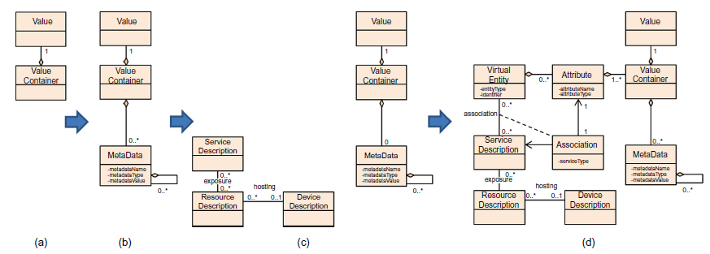

Slide 21
Virtual Entity context information is typically generated by data-producing devices such as sensor devices and consumed either by data-consumption
devices such as actuators or services (IoT or other types of services such as machine learning processing services). Raw or enriched information and/or
actionable information may be stored in caches or historical databases for later usage or processing, traceability, or accounting purposes. The

Slide 22
1.3 Information handling
An IoT system is typically deployed to monitor and control Physical Entities.
Monitoring and controlling Physical Entities is in turn performed by mainly the Devices, Communication, IoT Services, and Virtual Entity FGs in the functional view.
Certain FCs of these FGs, as well as the rest of the FGs
(Service Organization, IoT Process Management, Management, Security FGs), play a supporting role for the main FGs in the Reference Architecture,
and therefore in the flow of information.

Slide 23
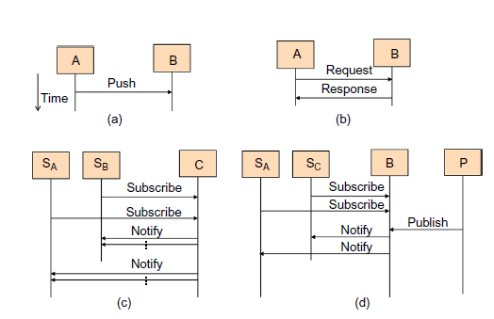
The presentation of information handling in an IoT system assumes that FCs exchange and process information. The exchange of information
between FCs follows the interaction patterns below

Slide 24
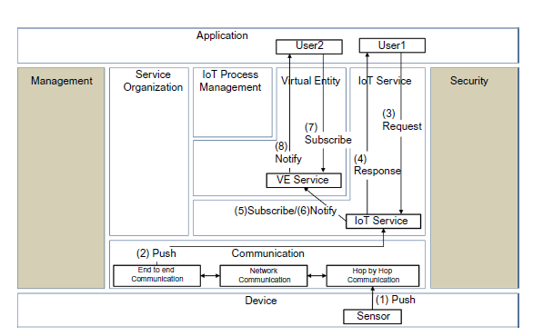
Device, IoT Service, and Virtual Entity Service Interactions.

Slide 25
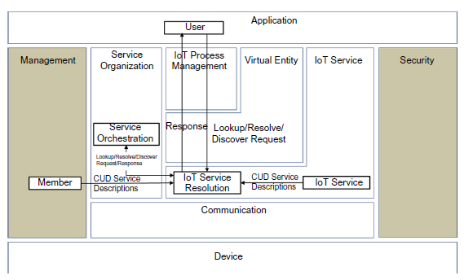
IoT Service Resolution

Slide 26
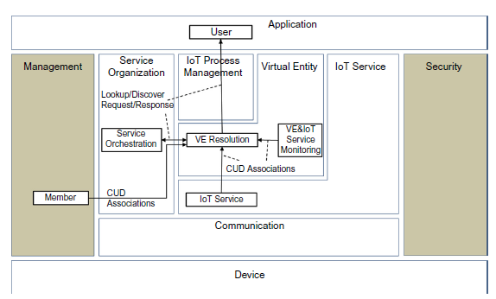
Virtual Entity Service Resolution

Slide 27
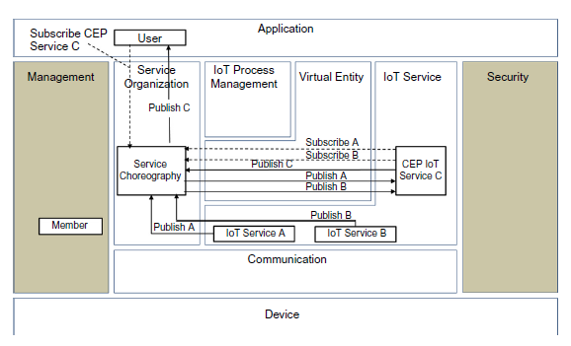
Service Choreography and Processing IoT Services

Slide 28
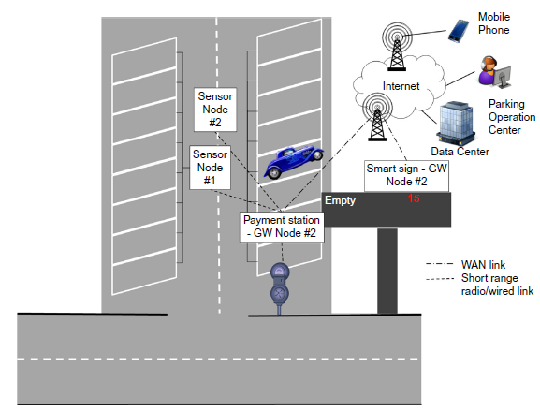
3.Deployment and operational view
The Deployment and Operational View depends on the specific actual use case and requirements.
Parking Lot Deployment and Operational View, Devices.

Slide 29
The two sensor nodes are connected to the payment station through wireless or wired communication. The payment station acts both as a user interface
for the driver to pay and get a payment receipt as well as a communication gateway that connects the two sensor nodes and the payment interface physical
devices (displays, credit card slots, coin/note input/output, etc.) with the Internet through Wide Area Network (WAN) technology.
The occupancy sign also acts as a communication gateway for the actuator node (display of free parking spots), and we assume that because of the deployment, a direct connection to the payment station is not feasible

Slide 30
The physical gateway devices connect through a WAN technology to the Internet and towards a data center where the parking lot management system software is
hosted as one of the virtual machines on a Platform as a configuration.
The two main applications connected to this management system are human user mobile phone applications and parking operation center applications.

Slide 31
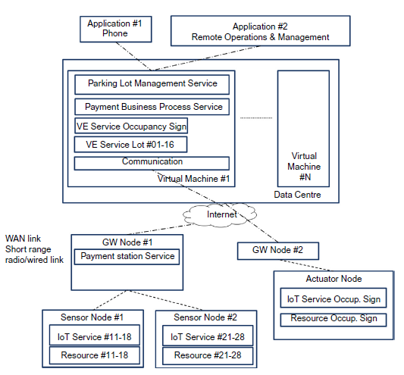

Slide 32
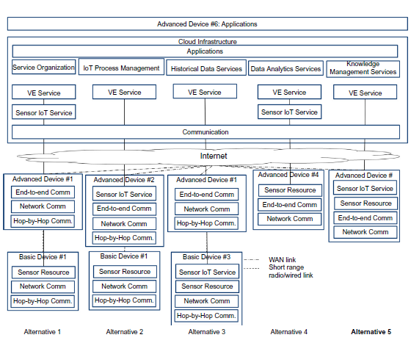
Mapping IoT Domain Model concepts to Deployment View.

